Slide 1
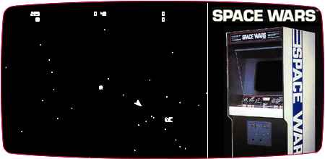
Modular of Aspects
Final Project,
SpaceWars AOP
Aviv Kotek, Raz Warman

Slide 2
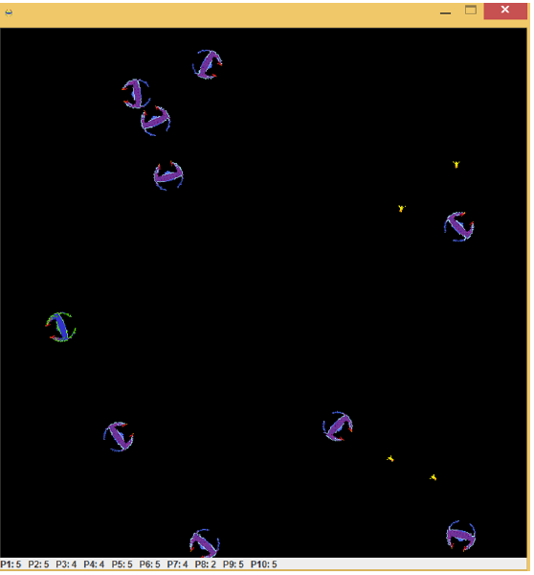
Base class: SpaceWars
Space Wars is a 1977 vector graphics arcade game Spacewar!.
We will use the version written by us in OOP course.

Slide 3
We will:
Use Java code with AspectJ for implementing Aspects.
Use @AspectJ annotations style – (more readable, “new” java style).
Implement our own annotations as pointCuts.
Add functionality to the game.
Use existing java frameworks.
Implement design patterns, logg, audit, control game behavior… and more!

Slide 4
Base class design
SpaceWars
UI Module
Teleport()
Shield()
Shoot()
Action
SpaceShip
All spaceship move methods
Interface
abstract
AggressiveShip
BasherShip
HumanShip
DrunkardShip
RunnerShip

Slide 5
Cross-cutting concerns
Concern - something that developer needs to care about (functionality, requirement)
Logging
Authorization
UI
Validation
Exceptions Handling
Design Patterns

Slide 6
Our main Aspects: 9x aspects
Spectative aspects:
Game Logging Aspect – saves data about game (time took, num of shots, start of game, etc..)
Audit Aspect – monitors and logs game events using wildcard && annotation, for auditing (security) and data analysis.
Singleton Aspect – singleton design pattern implementation using AOP.
Regulative Aspects:
Password authorization Aspect – only authorized users can play the game (using password).
UI update Aspect - each time space ship is terminated or do teleport action - we display a related animation on the screen.
Validator Aspect – validates parameters passed to methods in the codebase.
Invasive Aspects:
ExceptionHandler Aspect – handles unhandled exceptions.
ExceptionTranslator Aspect – translates exceptions from 3rd parties code.
FunctionalityAdder Aspect – adds interface implementations to existing classes (e.g: Serializable)

Slide 7
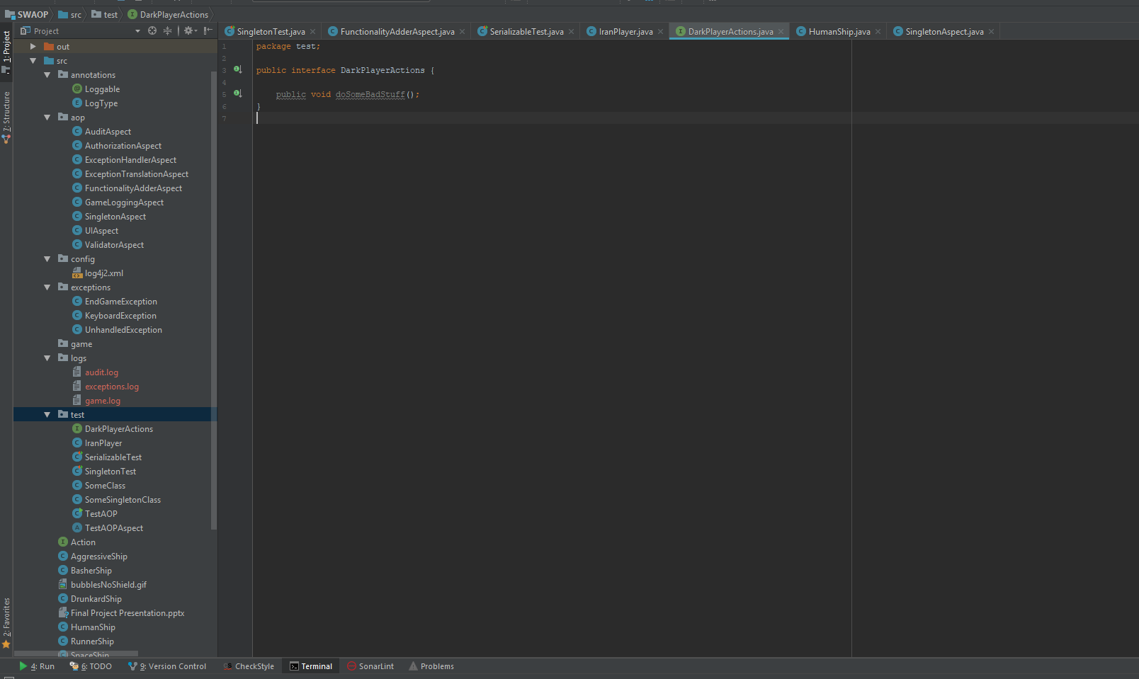
9x Aspect classes
1x xml
3x exceptions
1x annotation
6x Test related

Slide 8
In details

Slide 9
Spectative Aspects

Slide 10
Spectative Aspects:
Game Logging
Aspect
Audit
Aspect
Singleton Aspect

Slide 11
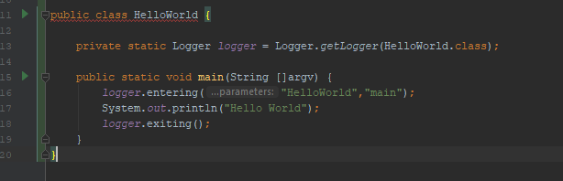
Logging Aspect, the concern:
Assume we have an ‘HelloWorld’ program, simple OOP impl will : have 8x LoC, in our app - 50% are log related! Assuming the ‘print’ option can be a database access or something more crucial – it can reduce the quality of our code. Logging is tangled up with the primary goal of this class (to print!). It has nothing to do with it. Removing it (or expressing it in a different way) can make our code much more clear (and cut it by half..).
Now assume we have a system with a lot of loggings, and one day Raz decides to change “entering” method into “debug”. His change commit will be terrible (HUGE!!), the logging is scattered all over the codebase.
and will require to perform many code changes.

Slide 12
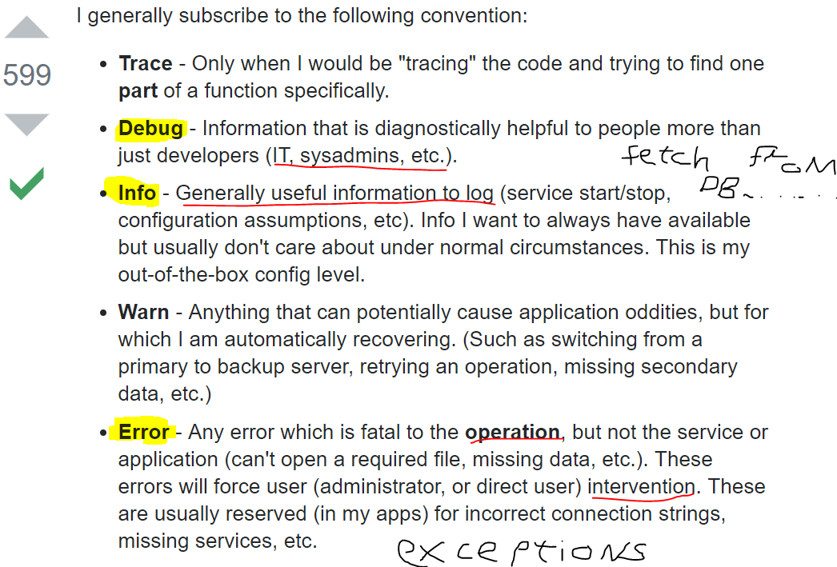
Log4j2
Apache license (open source) software, since 2001.
Most common logging framework in the java world.
Logging levels:
DEBUG, INFO, ERROR
Configure by.xml – separated from app
Can change logging level on RUNTIME!!
We logged in a synchronous way

Slide 13
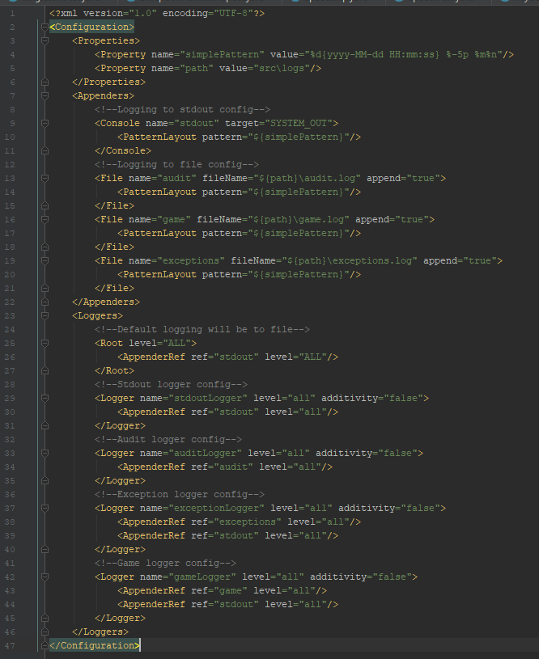
Log4j2 config file

Slide 14
Game Logging Aspect:
Concern: noted above
Pointcut:
Game analysis - total time game took, total shots made, total collisions.
Main game events – use custom annotation - @Loggable annotation to use in methods that do not conform with wildcard pattern.
Advice: Log code into logs/app.log file depends on annotation in runtime.

Slide 15
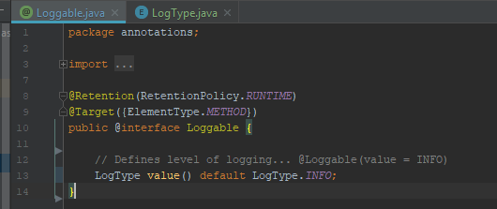
@Loggable
Custom made annotation
Programmer marks method with @Loggable annotation AND it typeLevel!
Retention: Source/Runtime – not-visible/visible by the compiler.
Target: Method – use this annot only on methods.

Slide 16
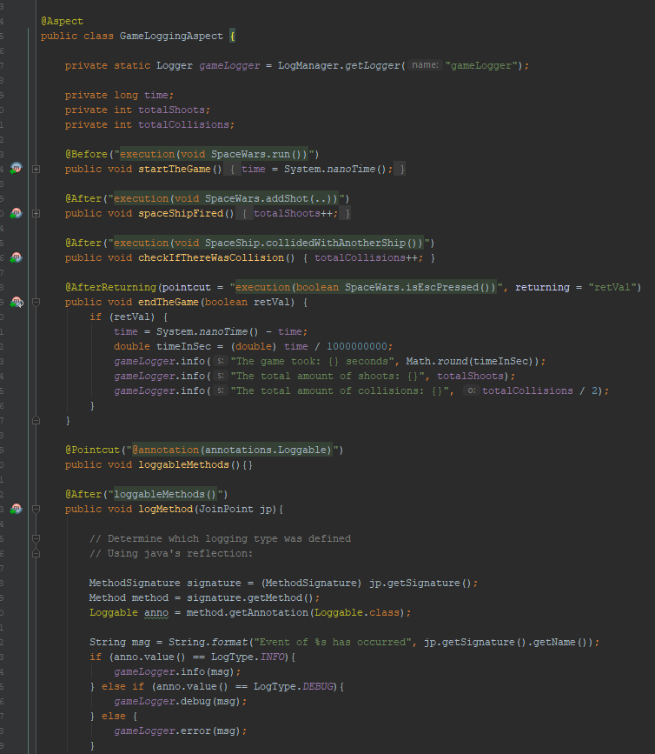

Slide 17
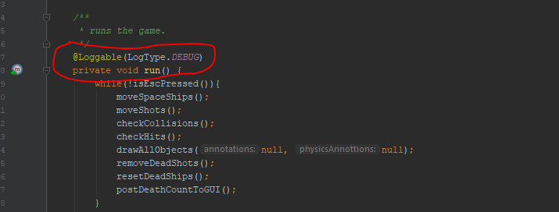
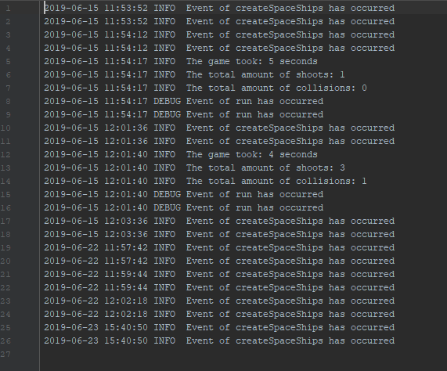

Slide 18
Audit Aspect:
Logs (audits) important events data to file, for later monitoring and security. (in real application we would like to log this to RDBMS).
E.G: change of Users password, change of orders, user activity and more.
Concern: monitor system actions.
Pointcut:
Set/get operations (using wildCard).
Do (interface) operations (after).
Advice: Log code into logs/app.log file depends on annotation in runtime.

Slide 19
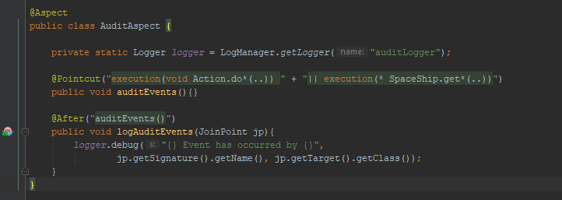
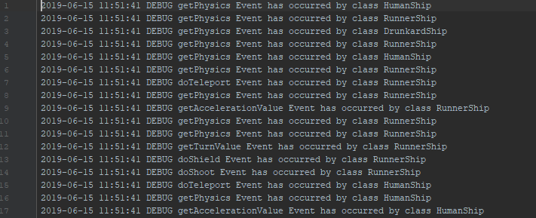

Slide 20
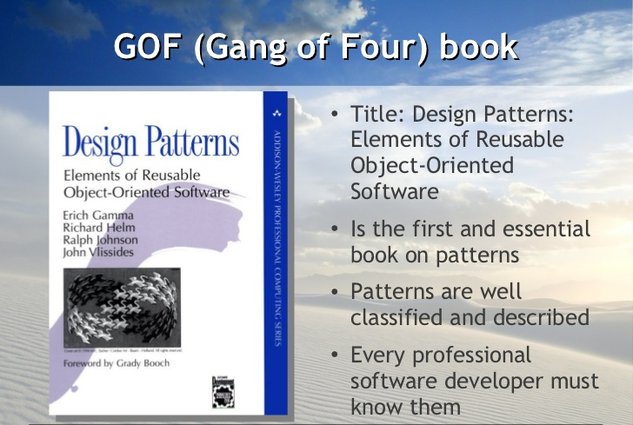
Design Patterns
Trying to implement design patterns using AOP instead of OOP.

Slide 21
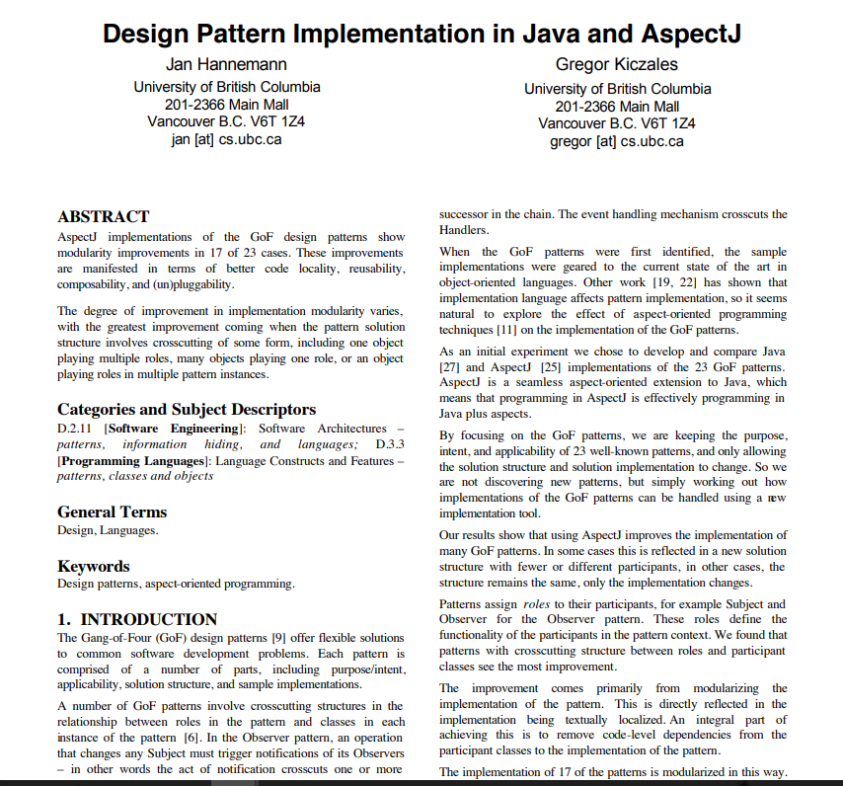
Design Patterns Aspect

Slide 22
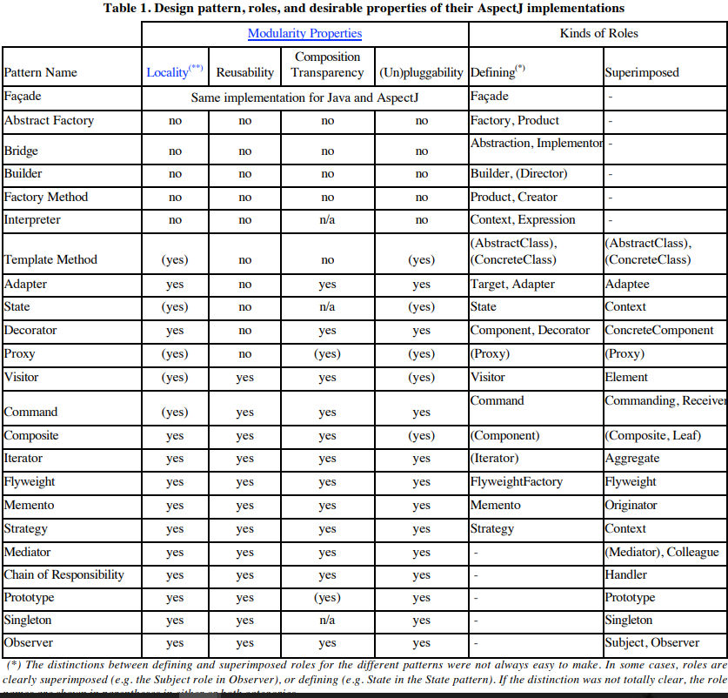
Design Patterns Aspect

Slide 23
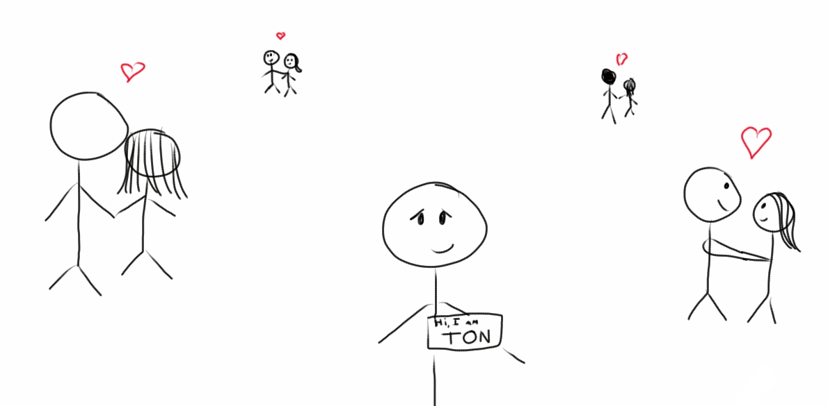
Singleton
The singleton pattern is a design pattern that restricts the instantiation of a class to one object.

Slide 24
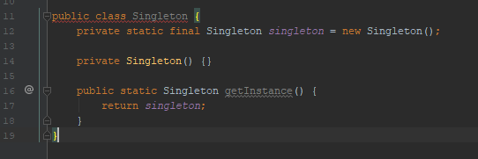
Singleton, the concern.
Normal OOP style of singleton will consist of writing this code in each of our Singleton instance. In our program – this can be relate to SpaceShipFactory. We can have many singletons in our codebase! Adding this code each time is tangling the class and will be scattered all over our application.

Slide 25
Design Pattern Aspect - Singleton
Concern: adding singleton implementation to each singleton class.
Pointcut: creation of SpaceWars game instance (.new(..) (only 1x == singleton))
Advice: intercepts calls to the constructor of the singleton class and instead of creating a new instance every time, return the instance that was created at the very fist call to the constructor.
Result: 1) much less code written, easy to handle and control from the 1x aspect! 2) flexibility – using annotations @Singleton as an example

Slide 26
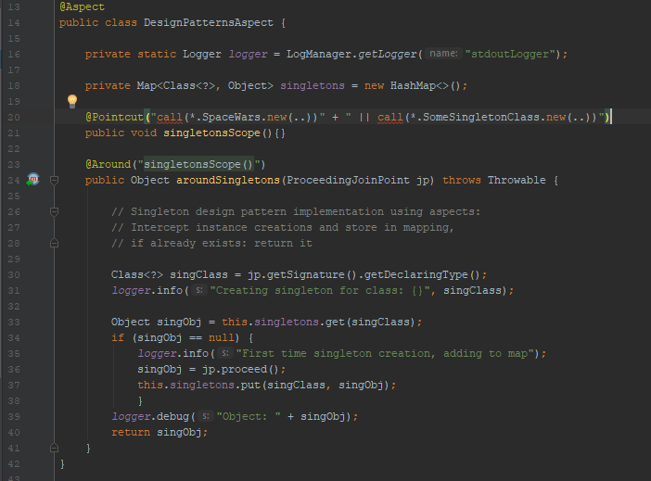
Design Pattern Aspect - Singleton

Slide 27
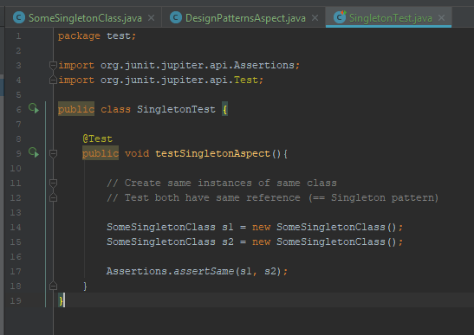
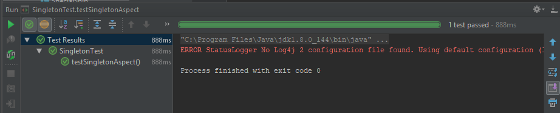
Design Pattern Aspect - Singleton

Slide 28
Regulative Aspects

Slide 29
Regulative Aspects:
Auth Aspect
UI Aspect
Validator Aspect

Slide 30
Authorization
Commercial product must have a system that manages the licenses of the legal users.
Usually the licenses come with unique key for every user/company.
Permission is given when using the appropriate password for specific license.
When developer deploy and run the product frequently on his machine, we don’t want that he will spend a lot of time on authentication.

Slide 31
Authorization Aspect:
Password authorization mechanism – only authorized users can play the game. Enforced using user/password login using JPasswordField.
Concern: give a permission to play the game only for legal users .
Pointcut: before the method that runs the game.
Advice: display a dialog box that require typing a legal password before start playing the game.

Slide 32
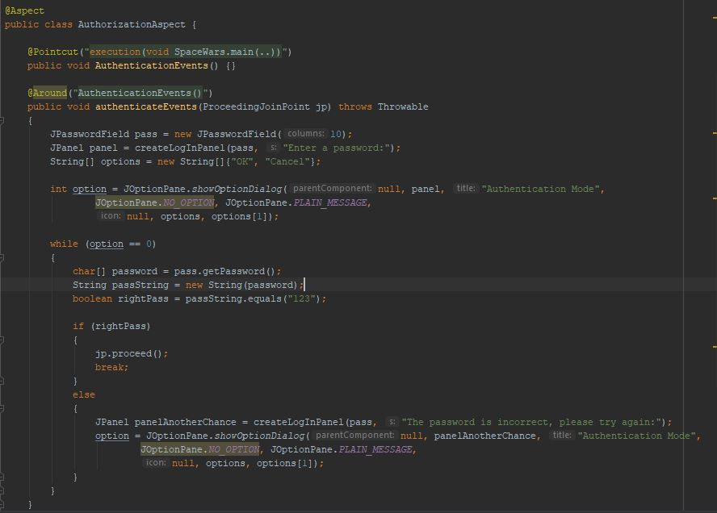

Slide 33
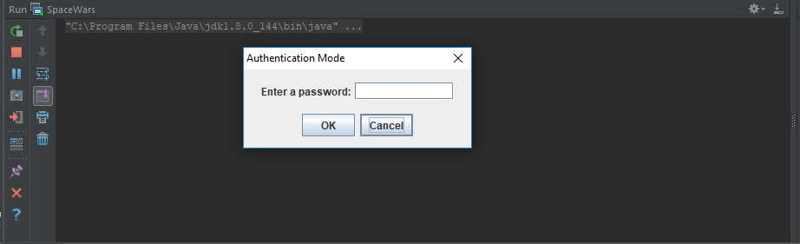

Slide 34
Extension of the UI/UX (Patch)
There are some situations that a commercial company will want to extend its product after releasing.
The reason could be earn more money, customer requests ,etc.
In many computer games there are some extensions for the UI/UX.
Because it is an extension, the company doesn’t want to affect the original product and its functionality and would like not to change the codebase but extend it in someway.

Slide 35


UI Aspect:
Update UI with informative message when fields/values are changed:
Teleport executed by SpaceShip.
SpaceShip died.
Concern: provide an upgraded gaming experience.
Pointcut: the data is collected when teleport/isDead methods are executed, and the animations are created before they are displayed
Advice: display a “Bang” animation when a spaceship is dead and a “Teleport” animation when a spaceship teleport itself.

Slide 36
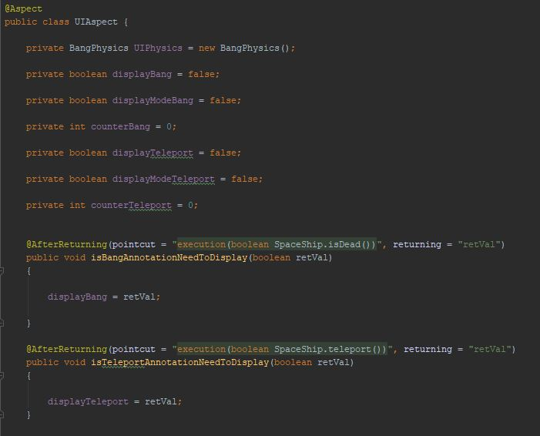

Slide 37
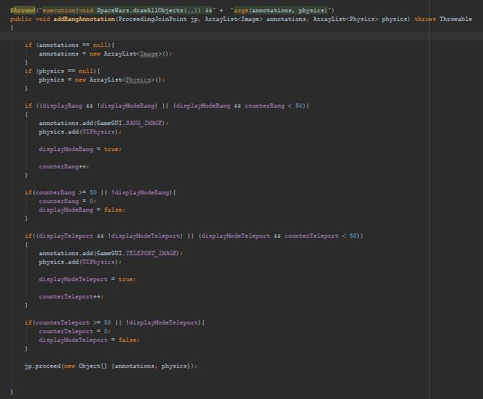

Slide 38
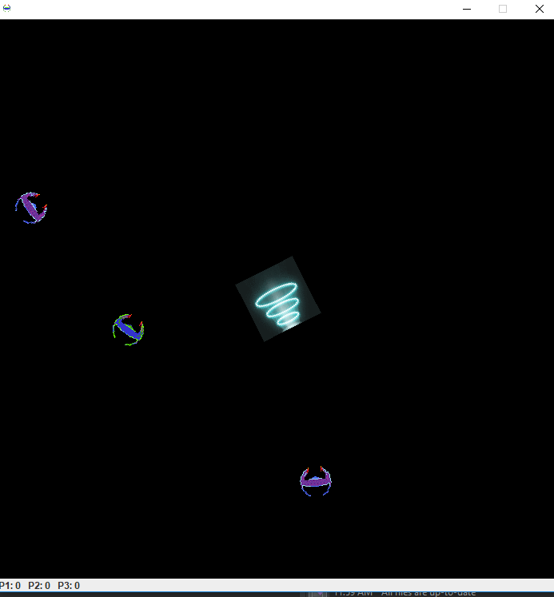


Slide 39
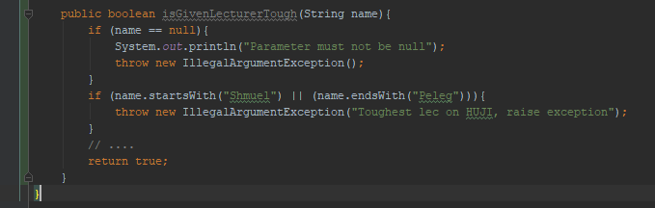
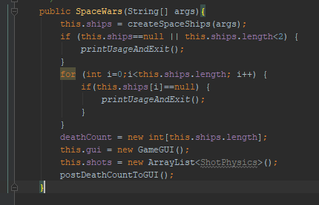
Validator Aspect, the concern:
Assume we want a smart way to validate methods in our code:
One way – checking method params each time.
In our game – manual code validation.

Slide 40
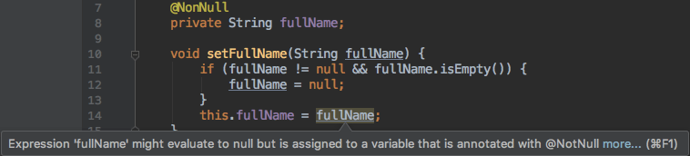
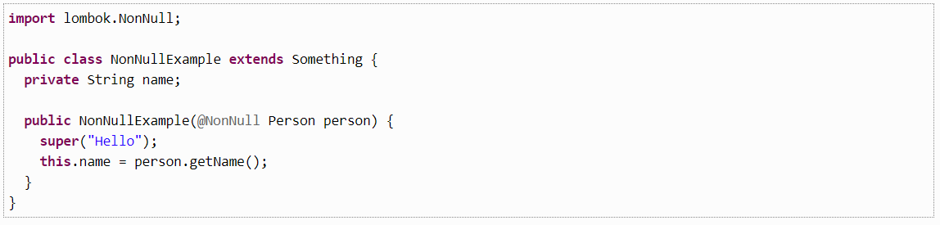
Validator Aspect, the concern:
Validation using spring
Another variant - using annotations with smart packages (Spring validation, Lombok).
Lots of code unrelated to the main logic of the method (tangling). Better way to separate whole system validation from the logic.
Lets do it AspectJ Way!
Validation using Lombok

Slide 41
Validator Aspect:
Validate all parameters passed to methods in our codebase.
Concern: validation of methods.
Pointcut: validate game launch parameters (which player we want to play).
Advice: throw an exception if parameters does not match pattern.

Slide 42
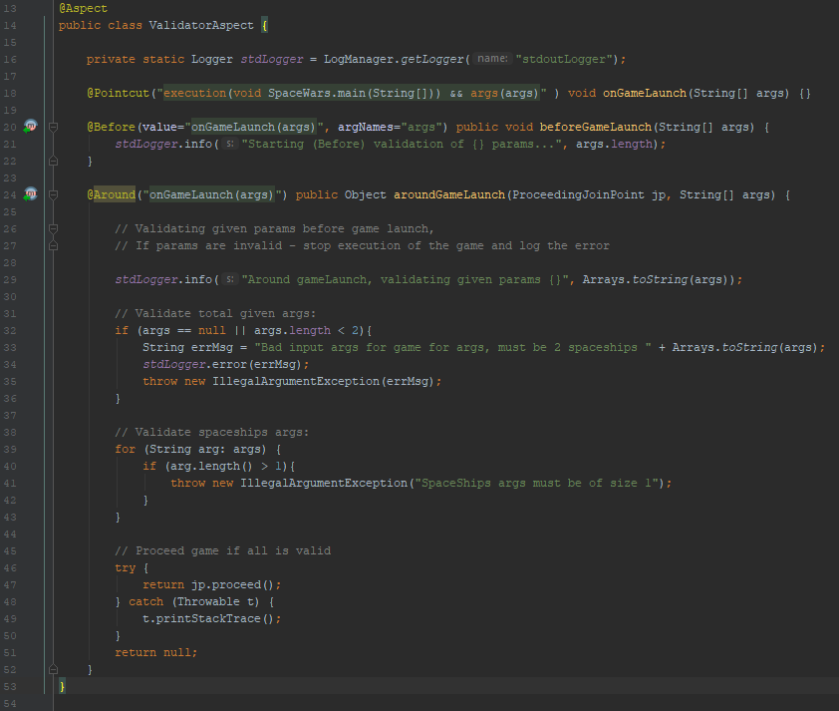
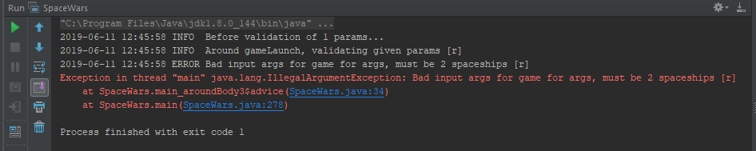

Slide 43
Invasive Aspects

Slide 44
Invasive Aspects:
ExceptionTranslationAspect
ExceptionHandler Aspect
FunctionalityAdder Aspect

Slide 45
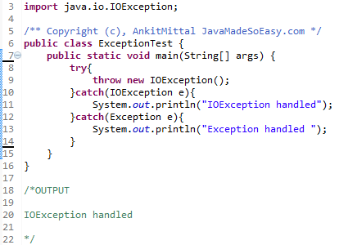
Exceptions:
When an exception is thrown in Java, it is passed up the call chain until it is either handled by a catch statement as part of a try/catch block or it reaches the Java run-time and causes a messy message on your console. If a Java exception is caught then we can handle the exception (log it, print it, ...).
It is useful to know when an exception has been handled/occurred.

Slide 46

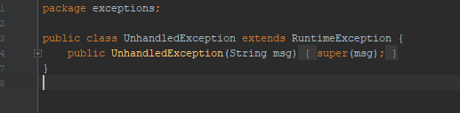
ExceptionHandlerAspect
Concern: exceptions not caught in code - monitor/handle them.
Pointcut: any exception is thrown but not handled (catched).
Advice: logs the exception and throws UnhandledException(msg).

Slide 47
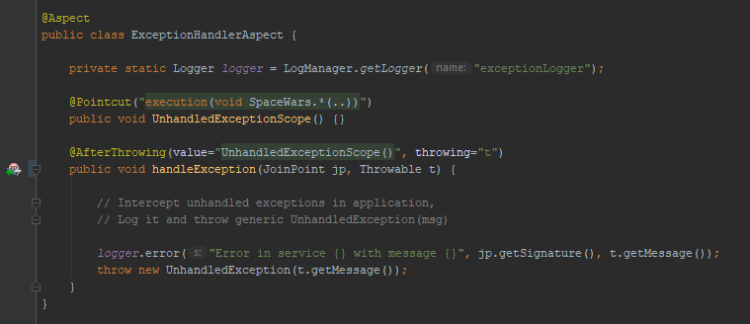
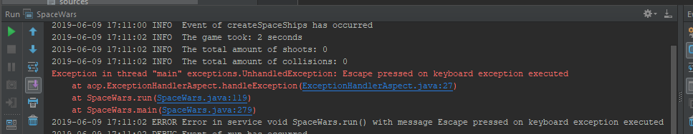

Slide 48
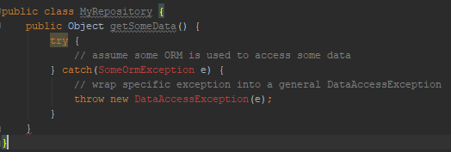
ExceptionTranslation Aspect, the concern:
Assume we use a third-party library (some ORM library) which helps us transform RDBMS tables to Java objects. This library throws exceptions (NoTableExistException, RecordException, etc…). We would like to convert those exceptions to our APPLICATION exceptions: DataAccessException, PersistenceLayerException.
Lots of code will be scattered over our codebase, with tangled conversions.
This can be taken care separately in an Aspect, making our code more clean and concise.

Slide 49
ExceptionTranslatorAspect
Concern: noted above.
Pointcut: a KeyboardException is thrown (ESC is pressed)
Advice: Translate 3rd party thrown exception into our application exception.
ProceedingJointPoint: an around advice is a special advice that can control when and if a method (or other join point) is executed. so they require an argument of type PJP, whereas other advices just use JP.

Slide 50
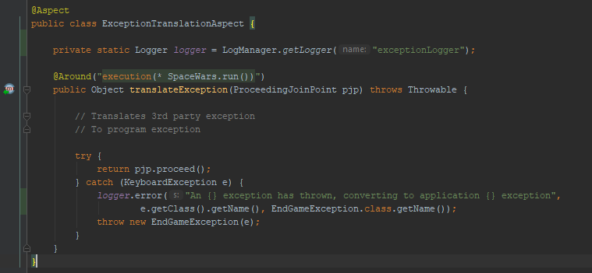
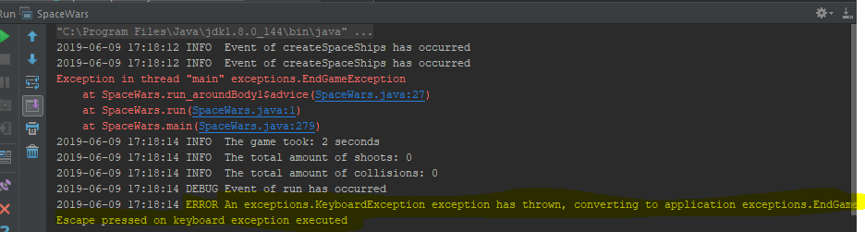
ExceptionTranslator Aspect

Slide 51
FunctionalityAdder Aspect
Concern: Assume we want to add some functionality to our code, Serialization for example, or Printability. Those are interfaces with default implementations (by java or by ourselves). We want those to be added only for 1x month without touching existing code, as our client wants this for short-term period. Instead of writing new interfaces or changing existing code, lets change our objects hierarchy with aspects!

Slide 52
FunctionalityAdder Aspect
Pointcut: we use ITD > @DeclareParents
Advice: none
Inter-type declarations, DeclareParents: Inter-type declarations in AspectJ are declarations that cut across classes and their hierarchies. They may declare members that cut across multiple classes, or change the inheritance relationship between classes. Unlike advice, which operates primarily dynamically, introduction operates statically, at compile-time.

Slide 53
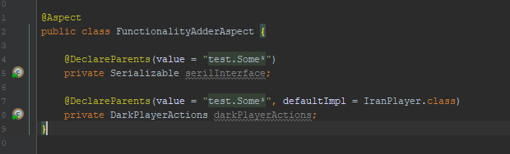
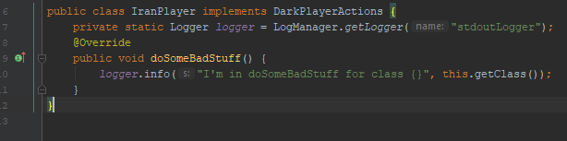

FunctionalityAdder Aspect
Adding serialization option to none-serialized classes.
Adding playing option with default impl!

Slide 54
